Slide 1

EEL 4781 Computer Communication Networks Chapter 4-1: Network Layer
Xin Xin
Department of Electrical and Computer Engineering
University of Central Florida

Slide 2
Agenda
Network layer: overview
data plane
control plane
What’s inside a router
input ports, switching, output ports
buffer management, scheduling

Slide 3
Network layer: our goals
Our Goals
understand principles behind network layer services, focusing on data plane:
network layer service models
forwarding versus routing
how a router works
generalized forwarding
instantiation, implementation in the Internet
IP protocol
NAT, middleboxes

Slide 4
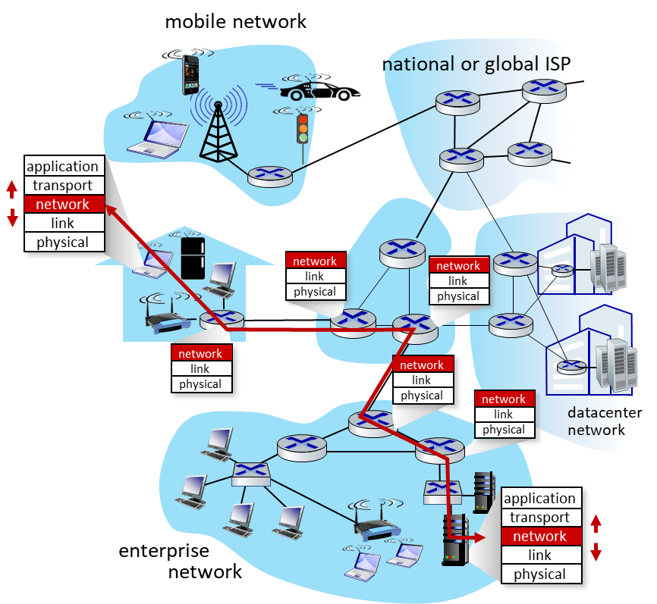
Network layer: overview
Network-layer services and protocols
transport segment from sending to receiving host
sender: encapsulates segments into datagrams, passes to link layer
receiver: delivers segments to transport layer protocol
network layer protocols in every Internet device: hosts, routers
routers:
examines header fields in all IP datagrams passing through it
moves datagrams from input ports to output ports to transfer datagrams along end-end path

Slide 5

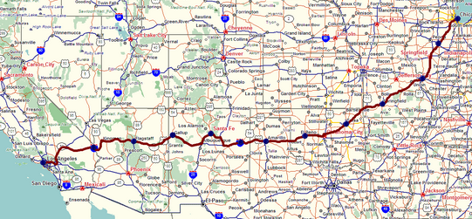
Network layer: overview
Two key network-layer functions
network-layer functions:
forwarding: move packets from a router’s input link to appropriate router output link
analogy: taking a trip
forwarding: process of getting through single interchange
routing: process of planning trip from source to destination
routing: determine route taken by packets from source to destination
routing algorithms
forwarding
routing

Slide 6
Network layer: overview
Network layer: data plane, control plane
Data plane:
local, per-router function
determines how datagram arriving on router input port is forwarded to router output port
Control plane
network-wide logic
determines how datagram is routed among routers along end-end path from source host to destination host
values in arriving
packet header
two control-plane approaches:
traditional routing algorithms: implemented in routers
software-defined networking (SDN): implemented in (remote) servers
0111
1
3
2

Slide 7

Network layer: overview
Per-router control plane
Individual routing algorithm components in each and every router interact in the control plane
Routing
Algorithm
control
plane
data
plane
values in arriving
packet header
0111
1
3
2

Slide 8
Network layer: overview
Software-Defined Networking (SDN) control plane
A distinct (typically remote) controller interacts with local control agents (CAs)
Remote Controller
control
plane
data
plane
CA
values in arriving
packet header
CA
CA
CA
CA
0111
1
3
2

Slide 9
Network layer: overview
Network service model
Network
Architecture
Internet
ATM
ATM
Internet
Internet
Quality of Service (QoS) Guarantees ?
Service
Model
best effort
Constant Bit Rate
Available Bit Rate
Intserv Guaranteed
(RFC 1633)
Diffserv (RFC 2475)
Bandwidth
none
Constant rate
Guaranteed min
yes
possible
Loss
no
yes
no
yes
possibly
Order
no
yes
yes
yes
possibly
Timing
no
yes
no
yes
no
Internet “best effort” service model
No guarantees on:
successful datagram delivery to destination
timing or order of delivery
bandwidth available to end-end flow

Slide 10
Network layer: overview
Network service model
Network
Architecture
Internet
ATM
ATM
Internet
Internet
Quality of Service (QoS) Guarantees ?
Service
Model
best effort
Constant Bit Rate
Available Bit Rate
Intserv Guaranteed
(RFC 1633)
Diffserv (RFC 2475)
Bandwidth
none
Constant rate
Guaranteed min
yes
possible
Loss
no
yes
no
yes
possibly
Order
no
yes
yes
yes
possibly
Timing
no
yes
no
yes
no

Slide 11
Network layer: overview
simplicity of mechanism has allowed Internet to be widely deployed adopted
sufficient provisioning of bandwidth allows performance of real-time applications (e.g., interactive voice, video) to be “good enough” for “most of the time”
replicated, application-layer distributed services (datacenters, content distribution networks) connecting close to clients’ networks, allow services to be provided from multiple locations
congestion control of “elastic” services helps
It’s hard to argue with success of best-effort service model

Slide 12
Agenda
Network layer: overview
data plane
control plane
What’s inside a router
input ports, switching, output ports
buffer management, scheduling

Slide 13
Router
Router architecture overview
high-level view of generic router architecture:
routing, management
control plane (software)
operates in millisecond
time frame
routing
processor
forwarding data plane (hardware) operates in nanosecond timeframe
high-speed
switching
fabric
router input ports
router output ports

Slide 14


Router
Input port functions
lookup,
forwarding
queueing
line
termination
link
layer
protocol
(receive)
switch
fabric
physical layer:
bit-level reception
Datagram
link layer:
e.g., Ethernet
(chapter 6)
decentralized switching:
using header field values, lookup output port using forwarding table in input port memory (“match plus action”)
goal: complete input port processing at ‘line speed’
input port queuing: if datagrams arrive faster than forwarding rate into switch fabric
Frame
Notes:
Green box is a physical layer responsible for receiving bit level transmission. Copper, fiber wireless.
Link layer in blue – bit assemble into Ethernet frame. We will discuss this in details in chapter 6.
But most critical one, is here. Lookup, forwarding function. Lookup and forward is “Match plus action” behavior.
GOAL – processing at “line speed”, otherwise, buffer will be full and packet will be lost

Slide 15
Router
lookup,
forwarding
queueing
line
termination
link
layer
protocol
(receive)
switch
fabric
physical layer:
bit-level reception
link layer:
e.g., Ethernet
(chapter 6)
decentralized switching:
using header field values, lookup output port using forwarding table in input port memory (“match plus action”)
destination-based forwarding: forward based only on destination IP address (traditional)
generalized forwarding: forward based on any set of header field values

Slide 16
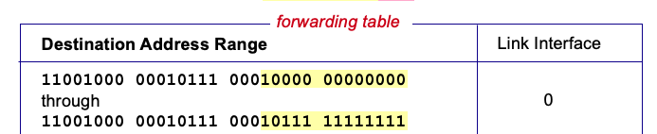

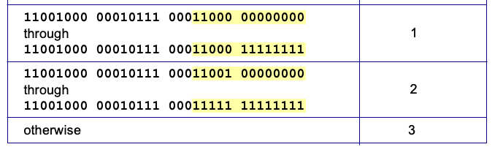
Router
Destination-based forwarding
3
Q: but what happens if ranges don’t divide up so nicely?
Notes:
Text for this animation:
This all works out pretty nice and looks pretty simple!
But of course the devil is in the details, as the saying goes.
What happens, for example, when a subset of addresses say in this first range should go to say interface 3, rather than interface 0. Well, of course we could split the first address range into multiple pieces, and add in this new subrange with its new destination output port. But it turns out there’s a much simpler and elegant way to do this. Known as longest prefix matching.

Slide 17
Router
Longest prefix matching
longest prefix match
when looking for forwarding table entry for given destination address, use longest address prefix that matches destination address.
Destination Address Range
11001000 00010111 00010
11001000 00010111 00011000
11001000 00010111 00011
otherwise
Link interface
0
1
2
3
***
********
********
***
********
examples:
11001000 00010111 00010110 10100001
which interface?
11001000 00010111 00011000 10101010
which interface?

Slide 18
Router
longest prefix match
when looking for forwarding table entry for given destination address, use longest address prefix that matches destination address.
Destination Address Range
11001000 00010111 00010
11001000 00010111 00011000
11001000 00010111 00011
otherwise
Link interface
0
1
2
3
***
********
********
match!
***
********
examples:
11001000 00010111 00010110 10100001
which interface?
11001000 00010111 00011000 10101010
which interface?

Slide 19
Router
longest prefix match
when looking for forwarding table entry for given destination address, use longest address prefix that matches destination address.
Destination Address Range
11001000 00010111 00010
11001000 00010111 00011000
11001000 00010111 00011
otherwise
Link interface
0
1
2
3
***
********
********
***
********
match!
examples:
11001000 00010111 00010110 10100001
which interface?
11001000 00010111 00011000 10101010
which interface?

Slide 20
Router
longest prefix match
when looking for forwarding table entry for given destination address, use longest address prefix that matches destination address.
Destination Address Range
11001000 00010111 00010
11001000 00010111 00011000
11001000 00010111 00011
otherwise
Link interface
0
1
2
3
***
********
********
***
********
match!
examples:
11001000 00010111 00010110 10100001
which interface?
11001000 00010111 00011000 10101010
which interface?

Slide 21
Router
Longest prefix matching
longest prefix matching: often performed using ternary content addressable memories (TCAMs)
content addressable: present address to TCAM: retrieve address in one clock cycle, regardless of table size
Cisco Catalyst: ~1M routing table entries in TCAM

Slide 22
Router
transfer packet from input link to appropriate output link
switching rate: rate at which packets can be transfer from inputs to outputs
often measured as multiple of input/output line rate
N inputs: switching rate N times line rate desirable
R
(rate: NR, ideally)
R
N input ports
. . .
high-speed
switching
fabric
. . .
N output ports
R
R

Slide 23
Router - Switching fabrics
transfer packet from input link to appropriate output link
switching rate: rate at which packets can be transfer from inputs to outputs
often measured as multiple of input/output line rate
N inputs: switching rate N times line rate desirable
three major types of switching fabrics:
memory
memory
bus
interconnection
network

Slide 24
Router - Switching fabrics
Switching via memory
first generation routers:
traditional computers with switching under direct control of CPU
packet copied to system’s memory
speed limited by memory bandwidth (2 bus crossings per datagram)
input
port
(e.g.,
Ethernet)
output
port
(e.g.,
Ethernet)
memory
system bus

Slide 25
Router - Switching fabrics
Switching via a bus
datagram from input port memory to output port memory via a shared bus
bus contention: switching speed limited by bus bandwidth
32 Gbps bus, Cisco 5600: sufficient speed for access routers

Slide 26
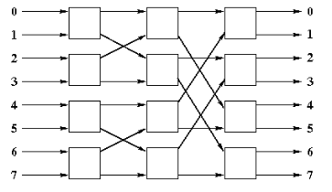
Router - Switching fabrics
Switching via interconnection network
overcome bus bandwidth limitations
banyan networks, crossbar, other interconnection nets initially developed to connect processors in multiprocessor
advanced design: fragmenting datagram into fixed length cells, switch cells through the fabric.
Cisco 12000: switches 60 Gbps through the interconnection network
crossbar
banyan network

Slide 27
Router - Queuing
Input port queuing
If switch fabric slower than input ports combined -> queueing may occur at input queues
queueing delay and loss due to input buffer overflow!
Head-of-the-Line (HOL) blocking: queued datagram at front of queue prevents others in queue from moving forward
switch
fabric
switch
fabric
one packet time later: green packet experiences HOL blocking
output port contention: only one red datagram can be transferred. lower red packet is blocked

Slide 28
Router - Queuing
Output port queuing
datagram
buffer
queueing
switch
fabric
(rate: NR)
link
layer
protocol
(send)
line
termination
R
Buffering required when datagrams arrive from fabric faster than link transmission rate. Drop policy: which datagrams to drop if no free buffers?
Datagrams can be lost due to congestion, lack of buffers
Scheduling discipline chooses among queued datagrams for transmission
Priority scheduling – who gets best performance, network neutrality

Slide 29
Router - Queuing
Output port queuing
switch
fabric
switch
fabric
at t, packets more
from input to output
one packet time later
buffering when arrival rate via switch exceeds output line speed
queueing (delay) and loss due to output port buffer overflow!

Slide 30
Router - Queuing
Buffer Management
buffer management:
drop: which packet to add, drop when buffers are full
tail drop: drop arriving packet
priority: drop/remove on priority basis
switch
fabric
datagram
buffer
queueing
scheduling
link
layer
protocol
(send)
line
termination
R
Abstraction: queue
marking: which packets to mark to signal congestion (ECN, RED)
R
packet
departures
packet
arrivals
queue
(waiting area)
link
(server)

Slide 31
Router - Scheduling
packet scheduling: deciding which packet to send next on link
first come, first served
priority
round robin
weighted fair queueing
FCFS: packets transmitted in order of arrival to output port
aka: First-in-first-out (FIFO)
real world examples?
Abstraction: queue
R
packet
departures
packet
arrivals
queue
(waiting area)
link
(server)

Slide 32
Router - Scheduling
Priority scheduling:
arriving traffic classified, queued by class
any header fields can be used for classification
high priority queue
arrivals
classify
link
departures
low priority queue
2
send packet from highest priority queue that has buffered packets
FCFS within priority class
1
3
4
5
arrivals
packet in service
1
3
2
4
5
departures
1
3
2
4
5

Slide 33
Router - Scheduling
Round Robin (RR) scheduling:
arriving traffic classified, queued by class
any header fields can be used for classification
server cyclically, repeatedly scans class queues, sending one complete packet from each class (if available) in turn
R
classify
arrivals
link
departures

Slide 34
Router - Scheduling
Weighted Fair Queuing (WFQ):
generalized Round Robin
each class, i, has weight, w_{i}, and gets weighted amount of service in each cycle:
w₁
w₂
R
w_{i}
Σ_{j}w_{j}
classify
arrivals
link
departures
w₃
minimum bandwidth guarantee (per-traffic-class)

Slide 35
Thanks
Acknowledgment
The materials for this course are in part based upon the materials from a number of people/sources, including:
Official website of the Kurose and Ross text: Computer Networking: A Top-Down Approach
Official website of the Tanenbaum & Wetherall text: Computer Networks
Dr. Murat Yuksel: https://www.ece.ucf.edu/~yuksem/teaching/EEL-4781-Fall-2020.html
Dr. Raj Jain: https://www.cse.wustl.edu/~jain/

Slide 36
Sidebar: Network Neutrality
What is network neutrality?
technical: how an ISP should share/allocation its resources
packet scheduling, buffer management are the mechanisms
social, economic principles
protecting free speech
encouraging innovation, competition
enforced legal rules and policies
Different countries have different “takes” on network neutrality

